Slide 1
Game ideas

Slide 2
Frogger… ish
In this version of Frogger, the player doesn't control the frog but instead controls the obstacles to prevent the frog from crossing to the other side of the river or road.
Features:
Obstacles with different speeds and movement patterns.
Increasing difficulty with multiple frogs trying to cross.

Slide 3
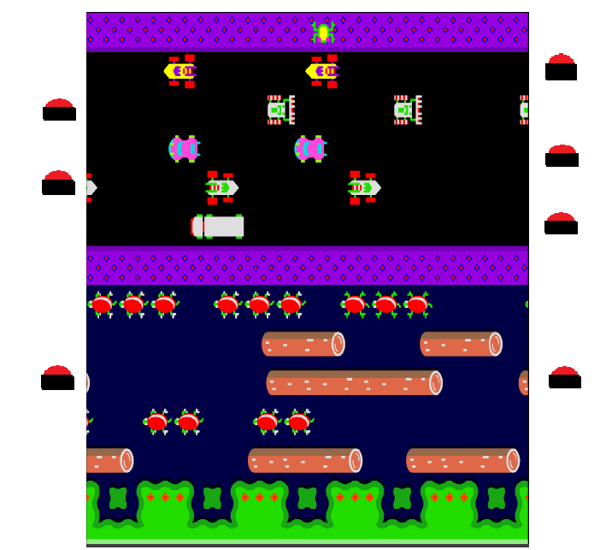
Click to spawn car
Click to spawn crocodile
Click to sink turtles

Slide 4
Tower Defense
The player has to defend a base by building towers at strategic points to stop waves of enemies.
Features:
Different tower types with unique abilities.
Waves of enemies with varying resistances and movement patterns.
Improve towers or unlock abilities.

Slide 5
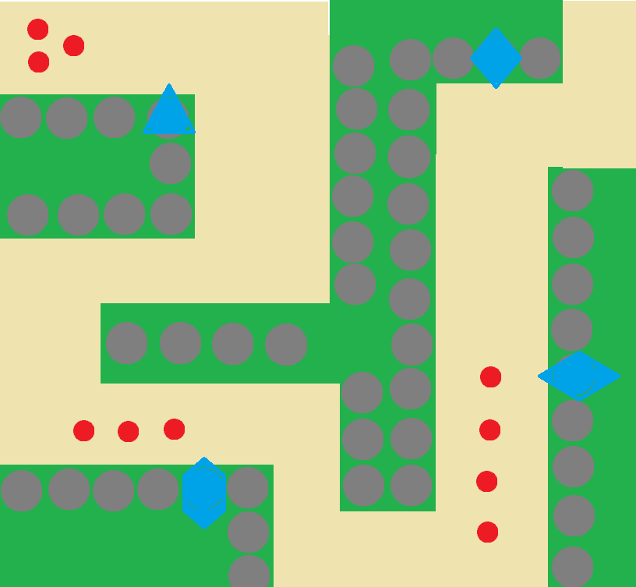

Slide 6
Marios
The player controls Mario, but with each level completed, another Mario appears. Eventually, the player controls all the Marios at once, solving puzzles and overcoming obstacles.
Features:
Puzzles that require coordination between the Marios.
Power-ups that affect all characters at once.

Slide 7
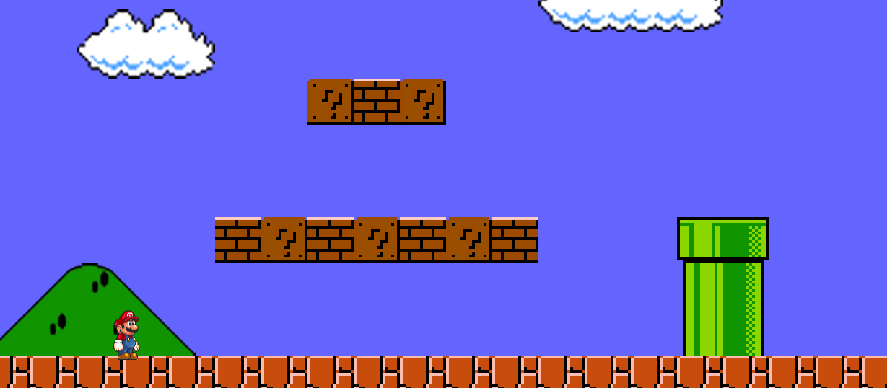
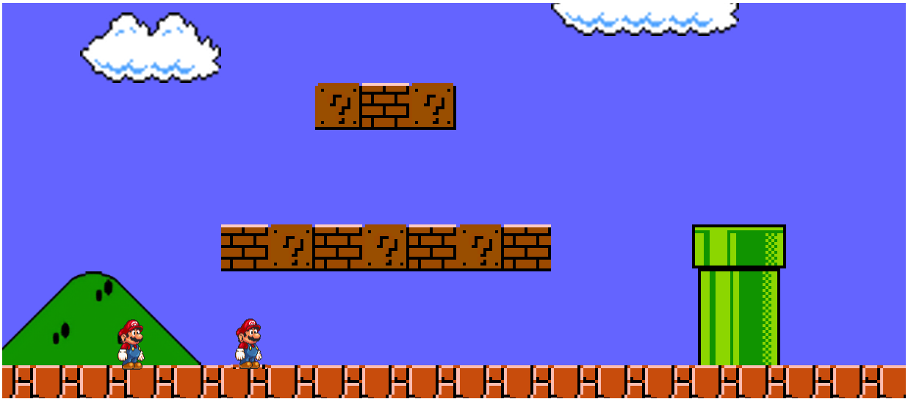
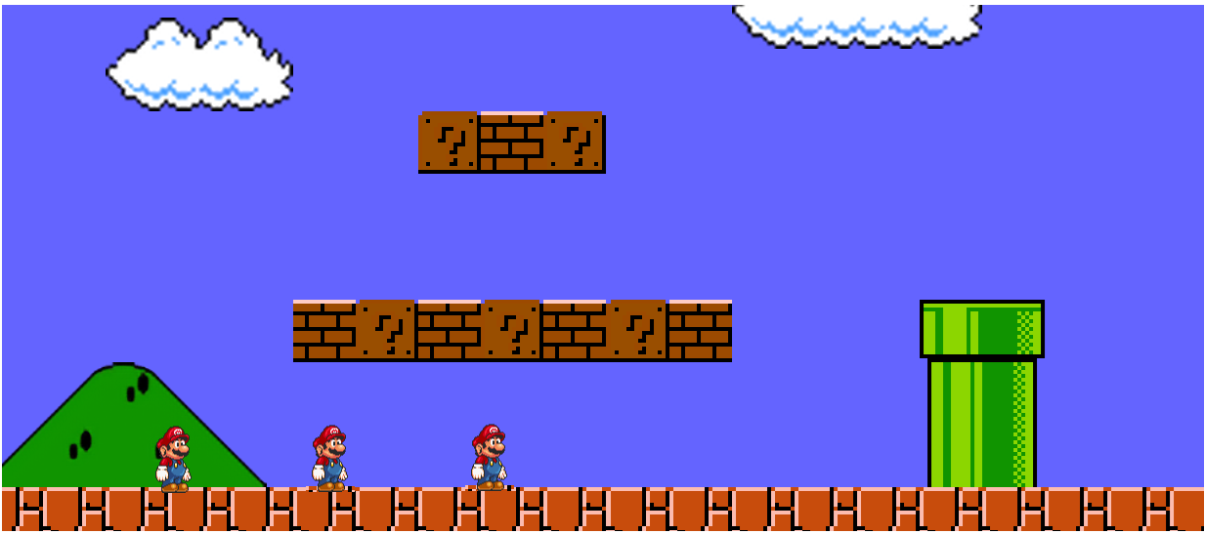
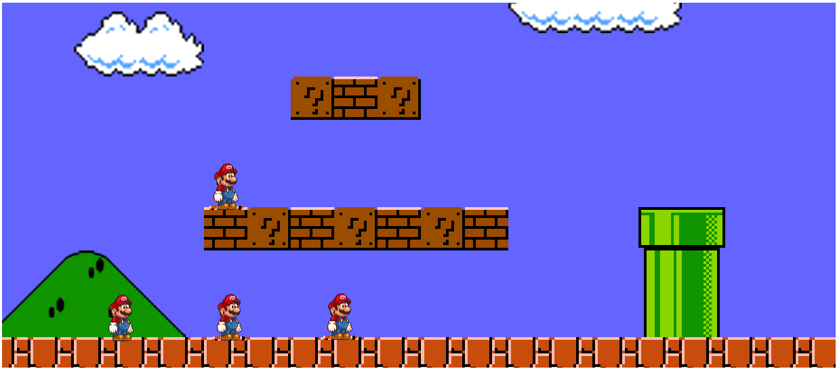

Slide 8
Pizzeria
The player works in a pizzeria and must complete pizza orders by collecting pizzas from the oven and delivering them to the counter or drive-thru before customers get impatient.
Features:
Power-ups that upgrade the oven’s velocity or player’s speed.
As the game progresses, the number of customers increases, and they become more demanding.

Slide 9
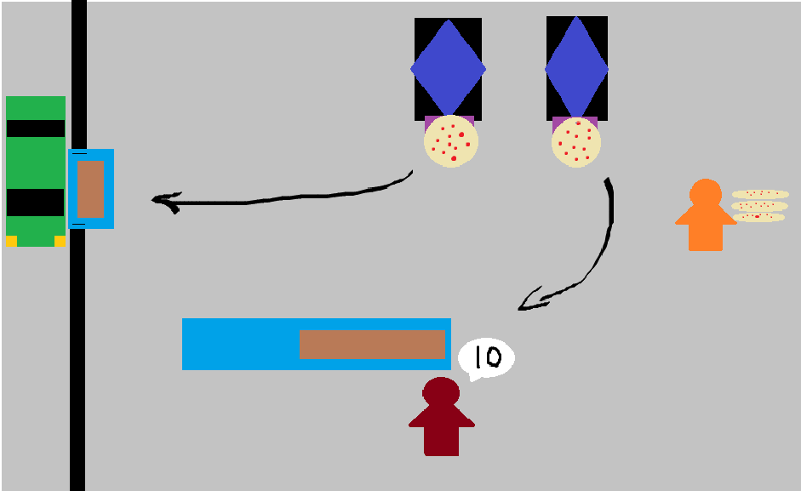

Slide 10
Trump in mario world
Instead of Mario is Donald Trump. The player must battle protesters instead of goombas, collect power-ups like the "Make America Great Again" cap and overcome obstacles to achieve his goal of annexing Canada as the 51st state.
Features:
Humorous power-ups.
Comical references to politics and pop culture.

Slide 11
